Slide 1
Meta Learning

Slide 2
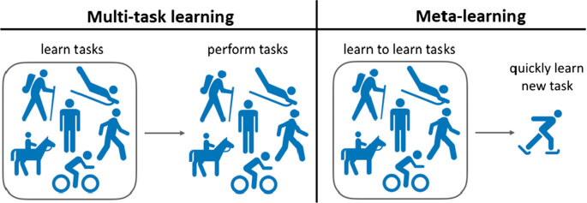
What is Meta-Learning?
If you have learned 100 tasks, given a new task, can you figure out how to learn more efficiently?
Now have multiple tasks is a huge advantage!
Meta-learning is very close to multitask learning
Meta-learning = learning to learn

Slide 3
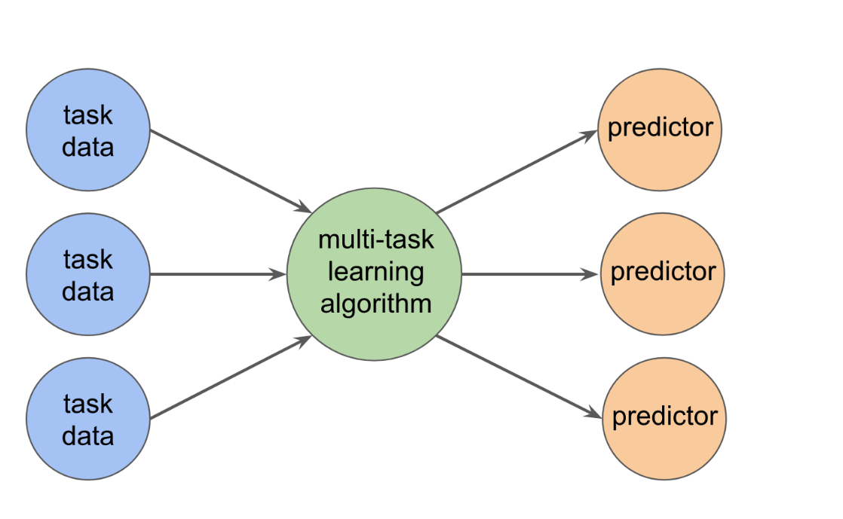
Multi-task Learning

Slide 4
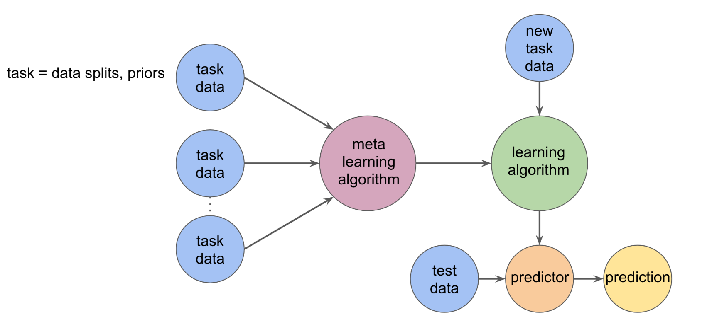
Meta Learning

Slide 5
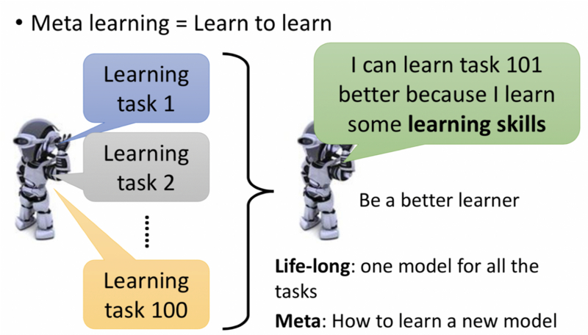
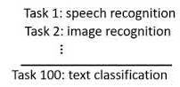
Meta Learning

Slide 6
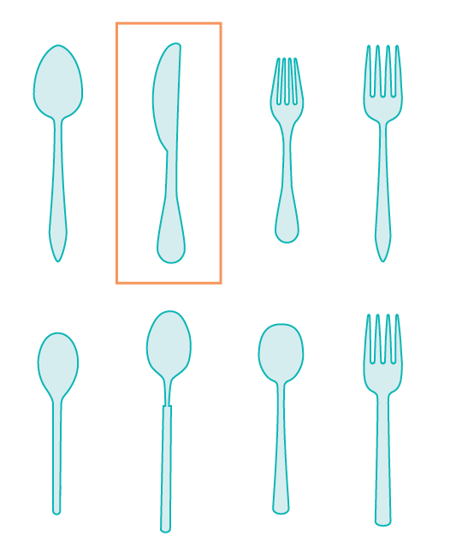
Meta Learning
Humans are successful in adapting and learning quickly is that they leverage knowledge acquired from prior experience to solve novel tasks.
With only few instances of knife, a small child can also
learn to distinguish knife from spoons and glasses.

Slide 7
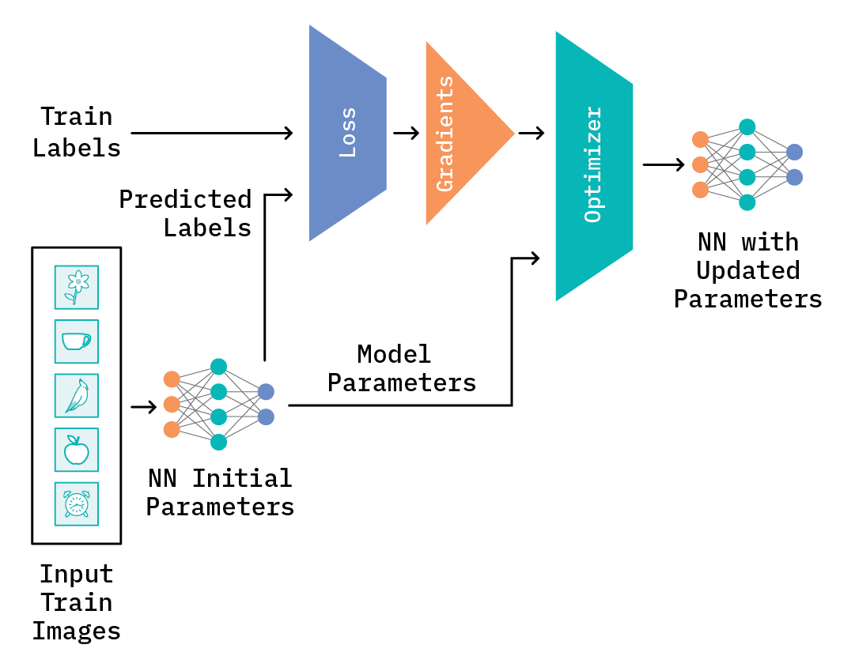
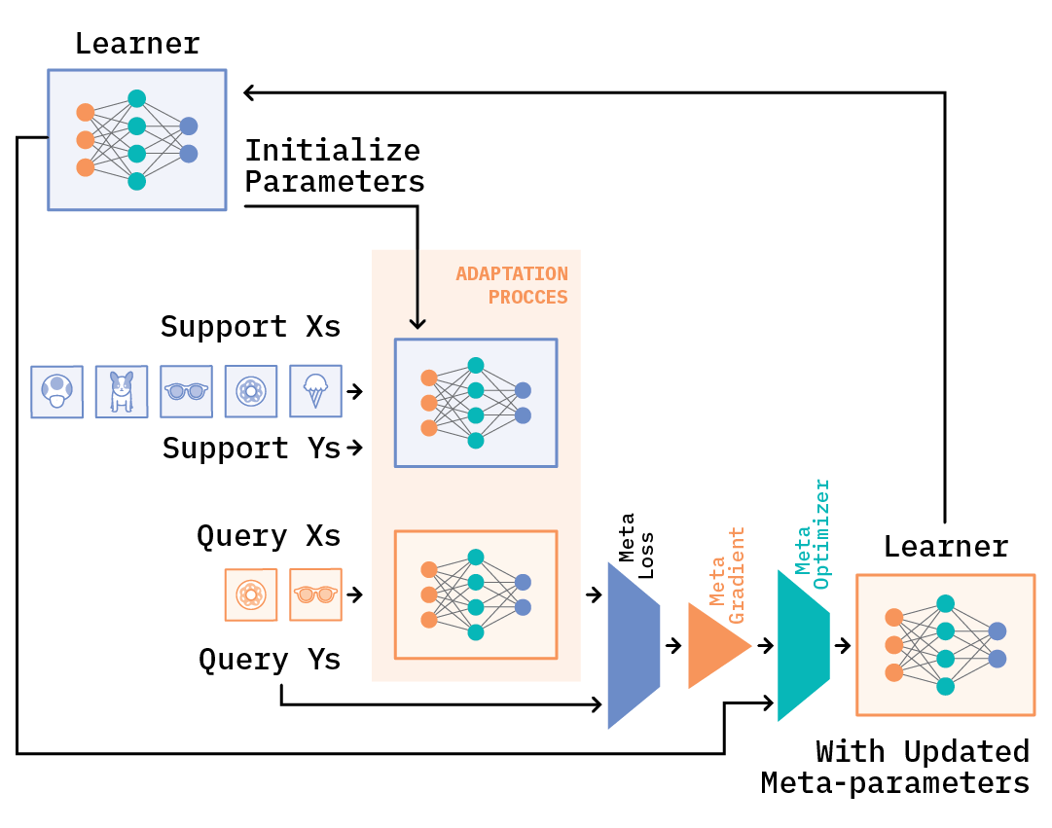
Meta Learning
A training step in normal training process - adopted from HuggingFace’s blog post, “From zero to research”
Learning to learn

Slide 8
Why is meta-learning a good idea?
Deep learning works very well, but requires large datasets
In many cases, we only have a small amount of data available (e.g., some specific computer vision task), but we might have lots of data of a similar type for other tasks (e.g., other object classification tasks)

Slide 9
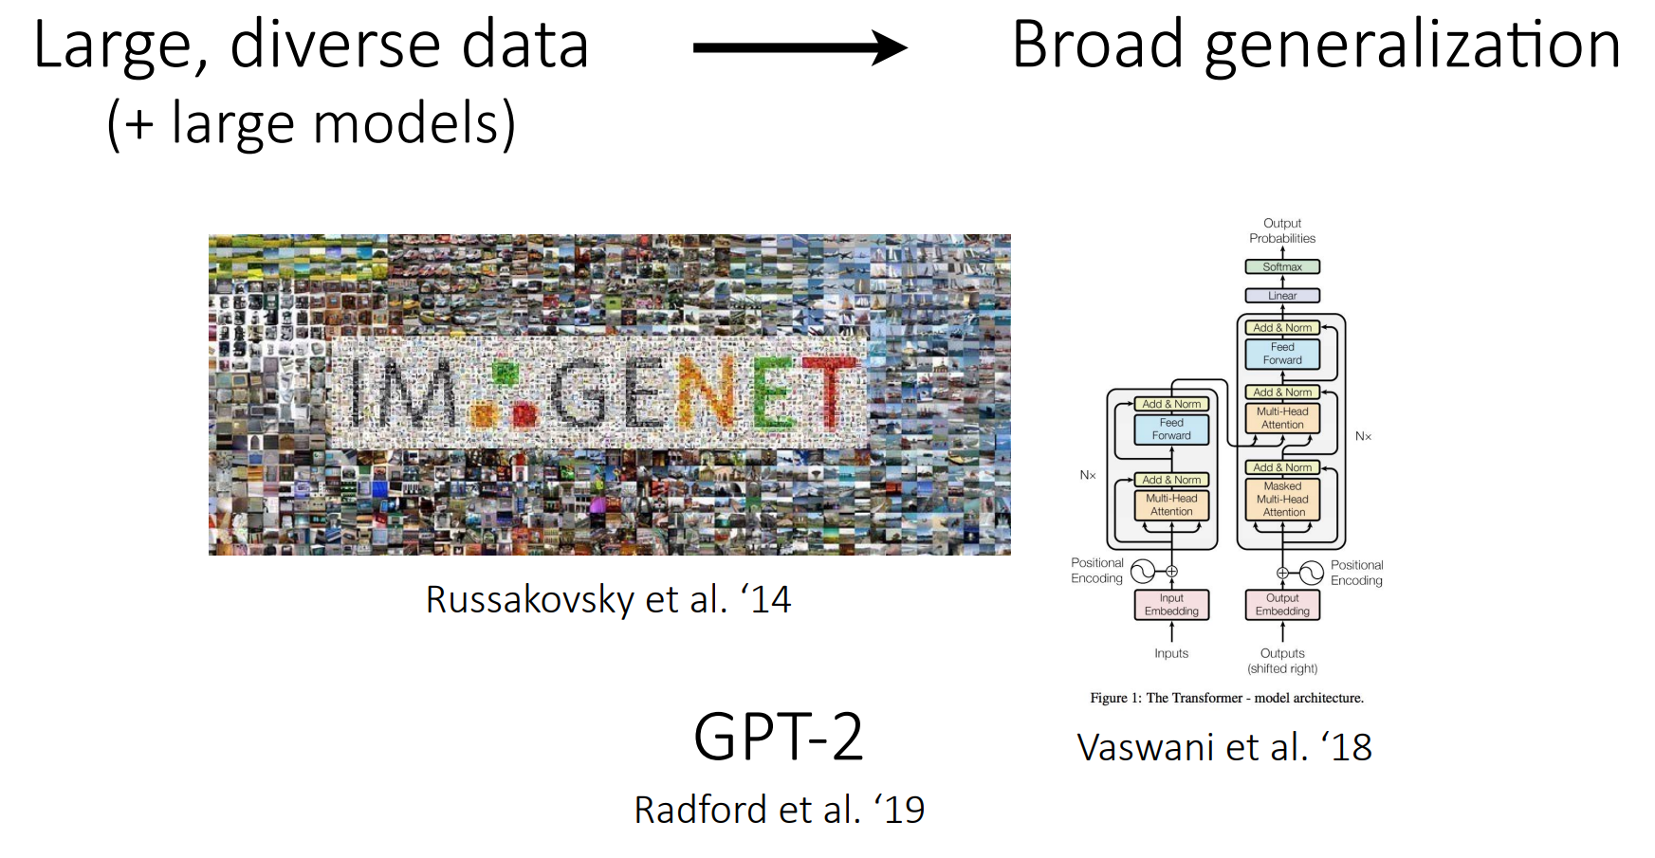
Pre trained Models

Slide 10
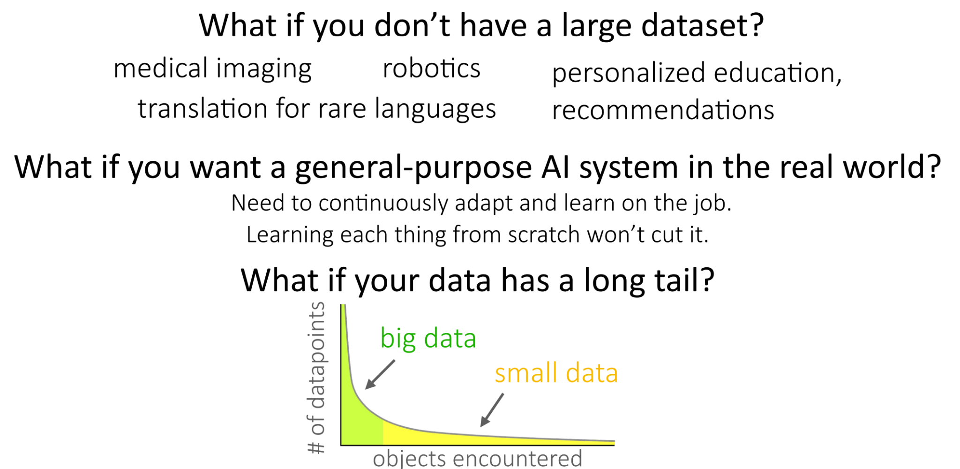
Why Meta Learning ?

Slide 11
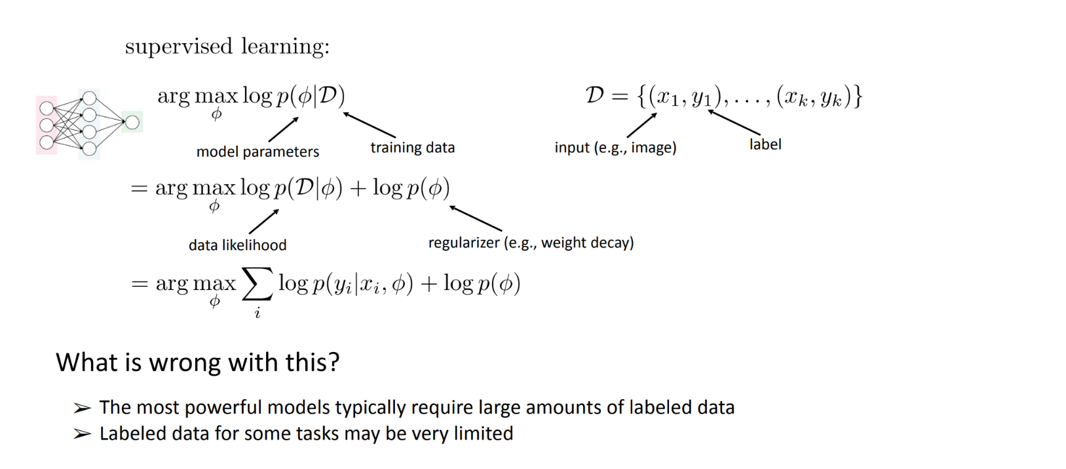
Why Meta Learning ?

Slide 12
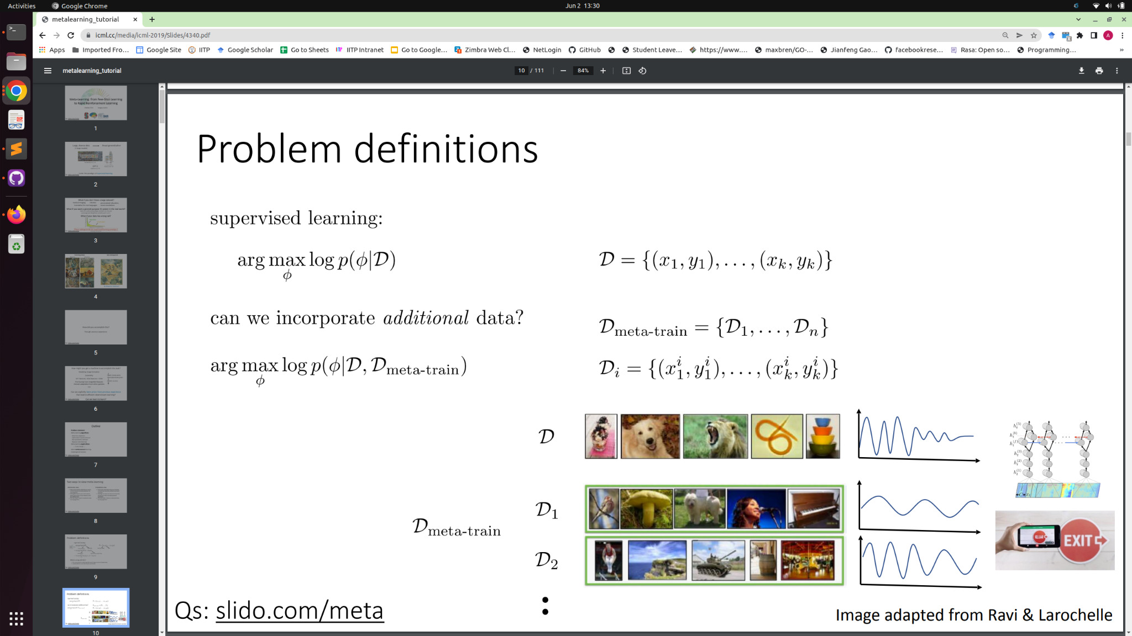
Meta Learning

Slide 13
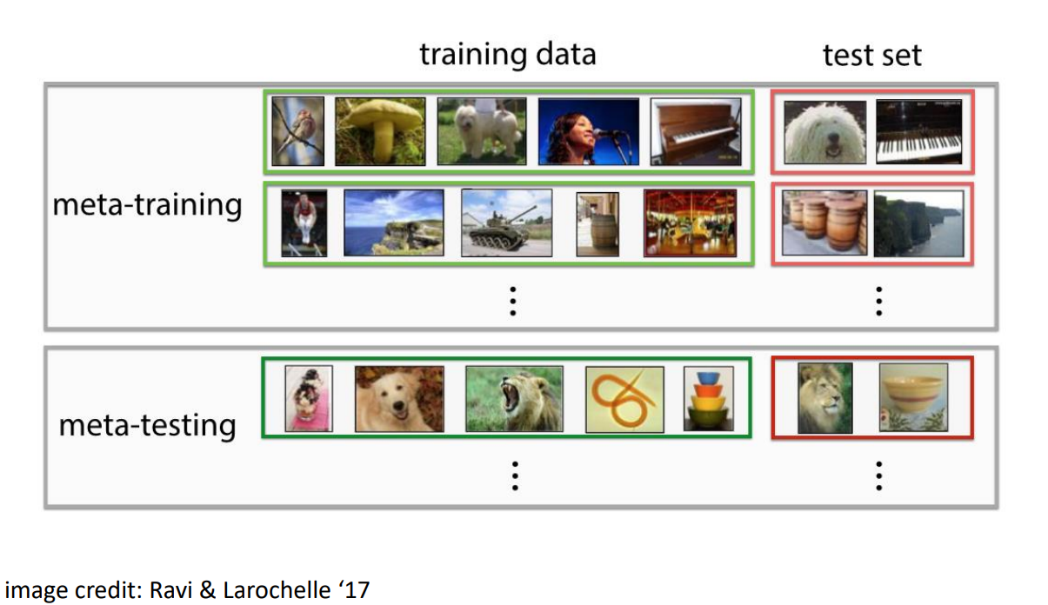
Why is meta-learning a good idea?
Use plentiful prior tasks to meta-train a model that can learn a new task quickly with only a few examples
Collect a small amount of labeled data for the new task
Learn a model on this new dataset that generalizes broadly

Slide 14
Why is meta-learning a good idea?
Increased model prediction clarity
Less expensive and quicker training process
Increasing the generalizability of models

Slide 15
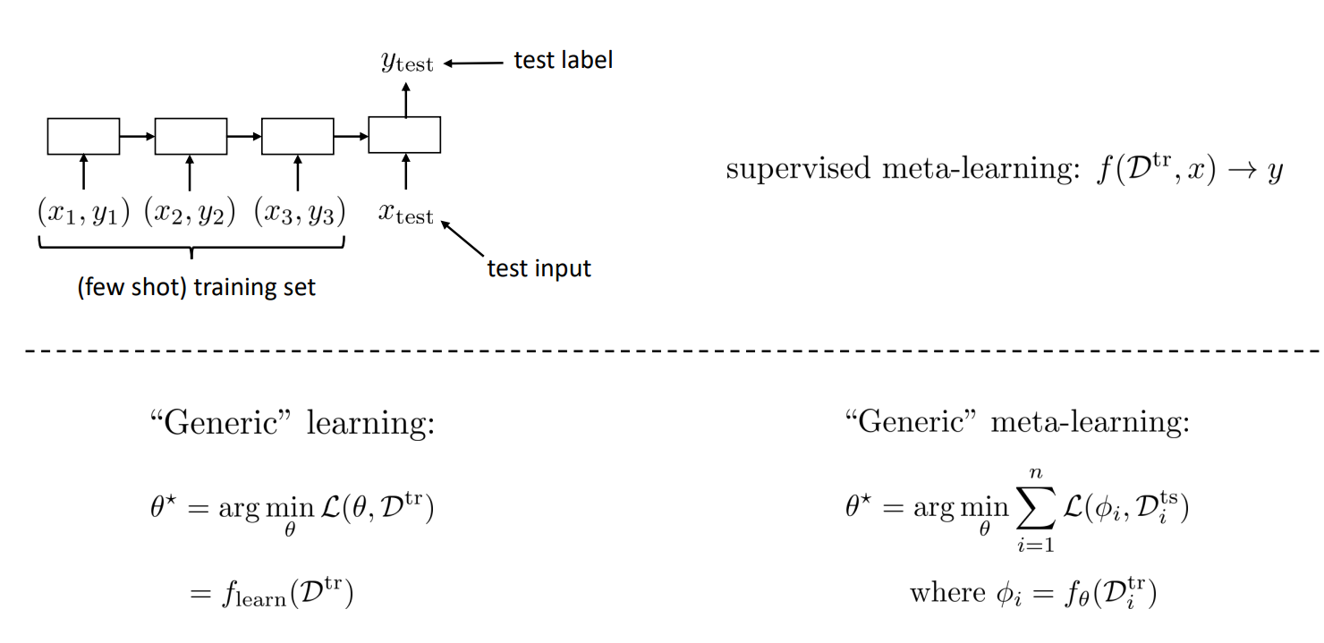
How Meta Learning Works ?

Slide 16
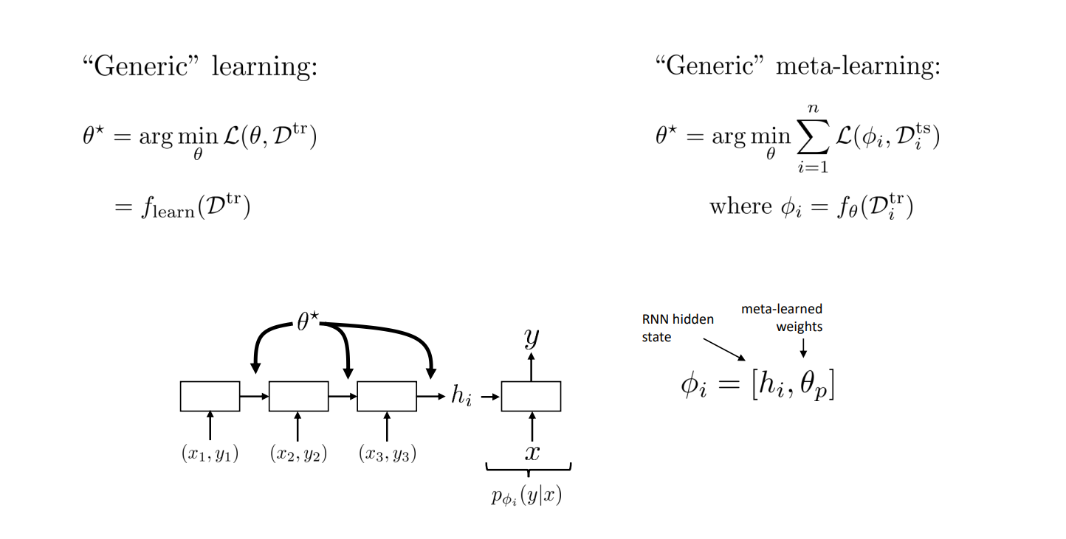
How Meta Learning Works ?

Slide 17
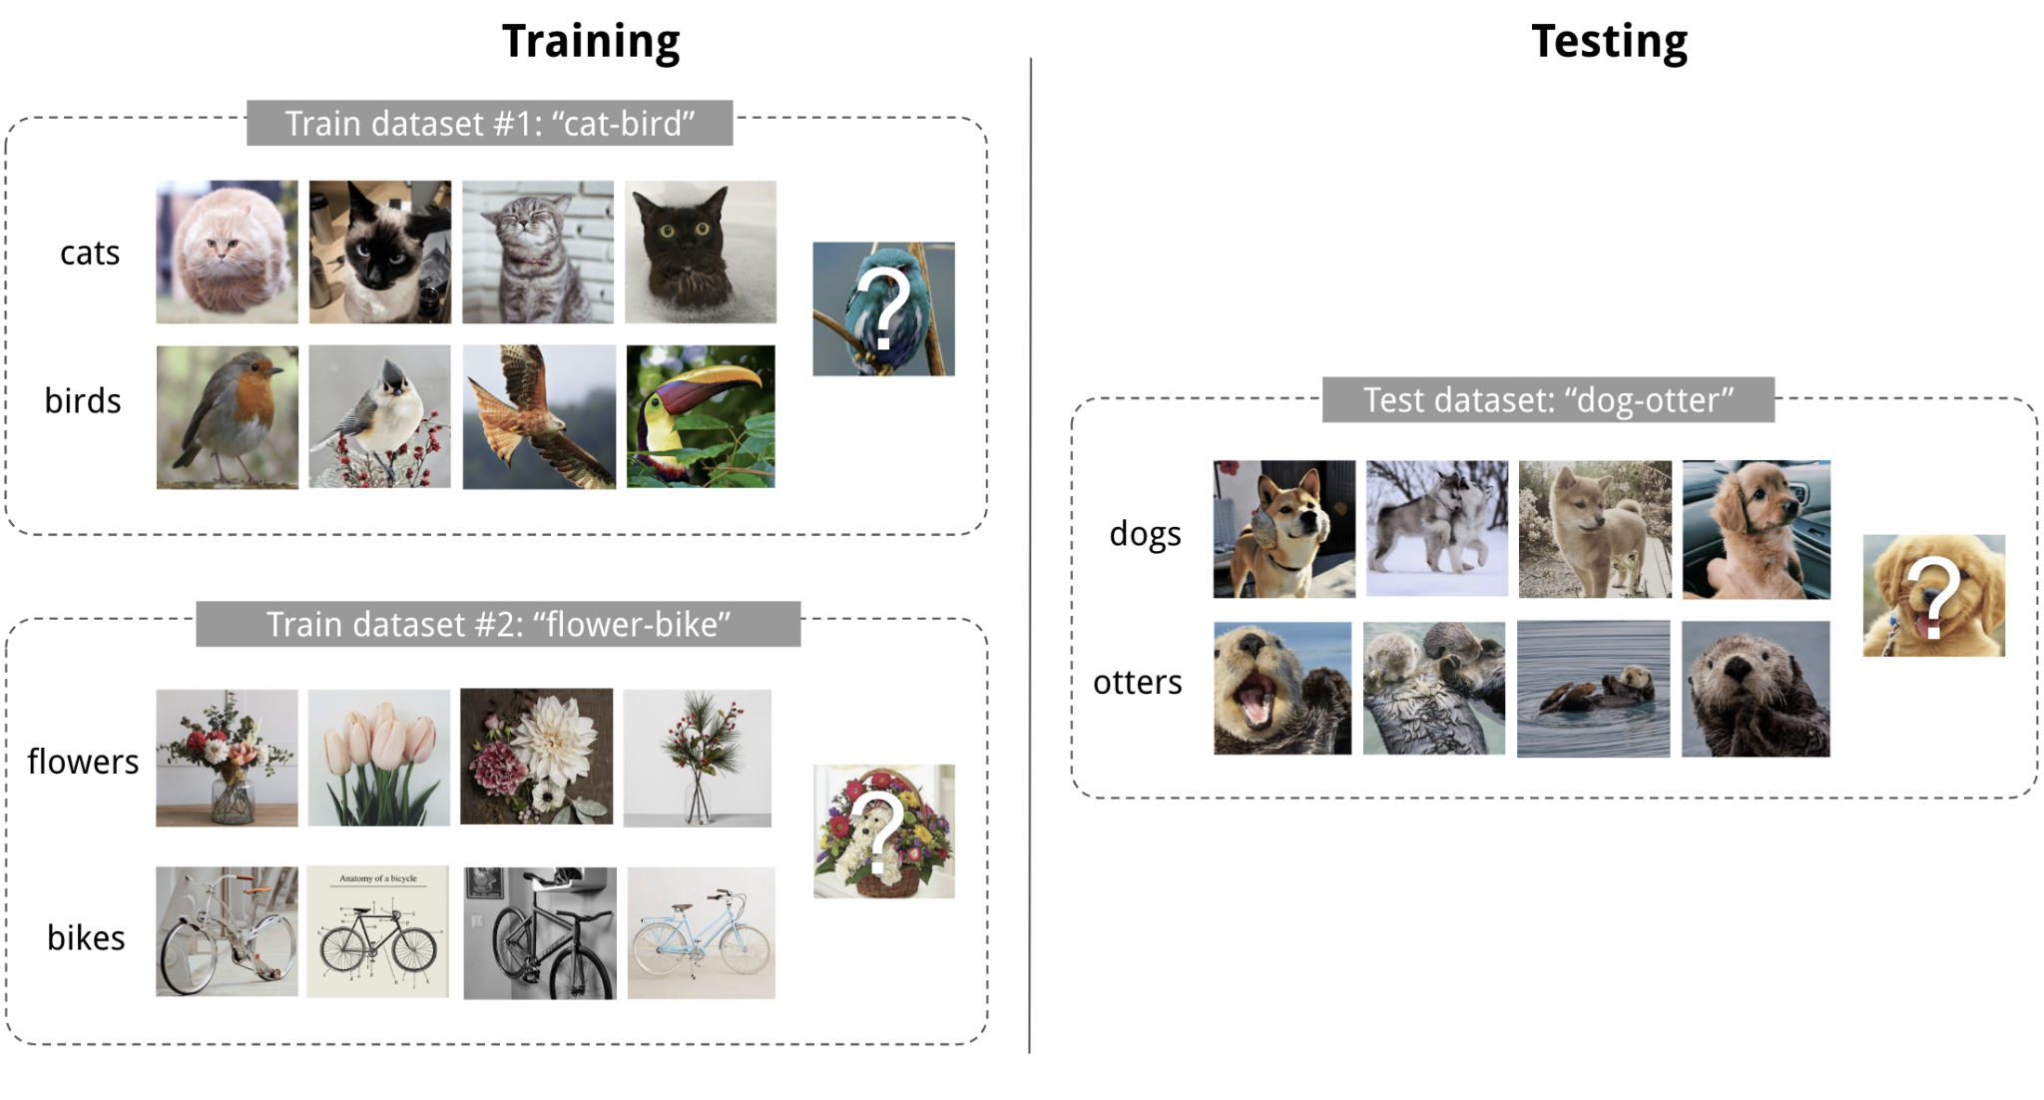
An Illustration
An example of 4-shot 2-class image classification

Slide 18
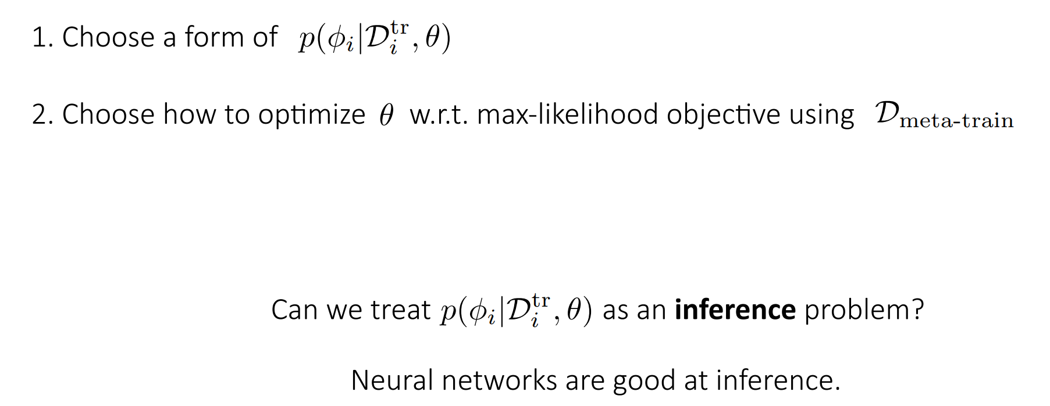
How to design a meta-learning algorithm

Slide 19
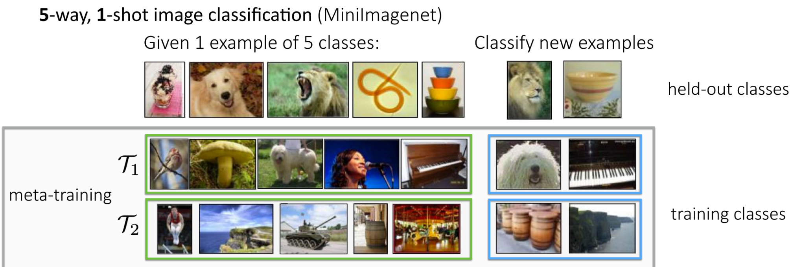
How to evaluate Meta Learning Algorithm

Slide 20
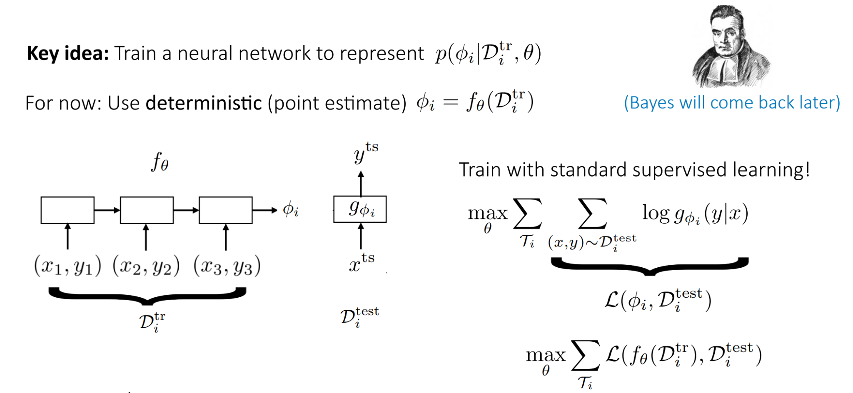
Black Box Adaptation

Slide 21
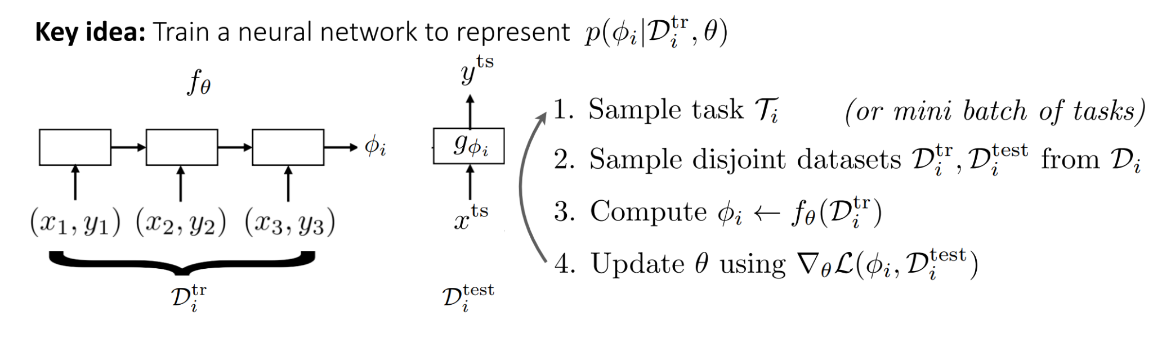
Black Box Adaptation

Slide 22
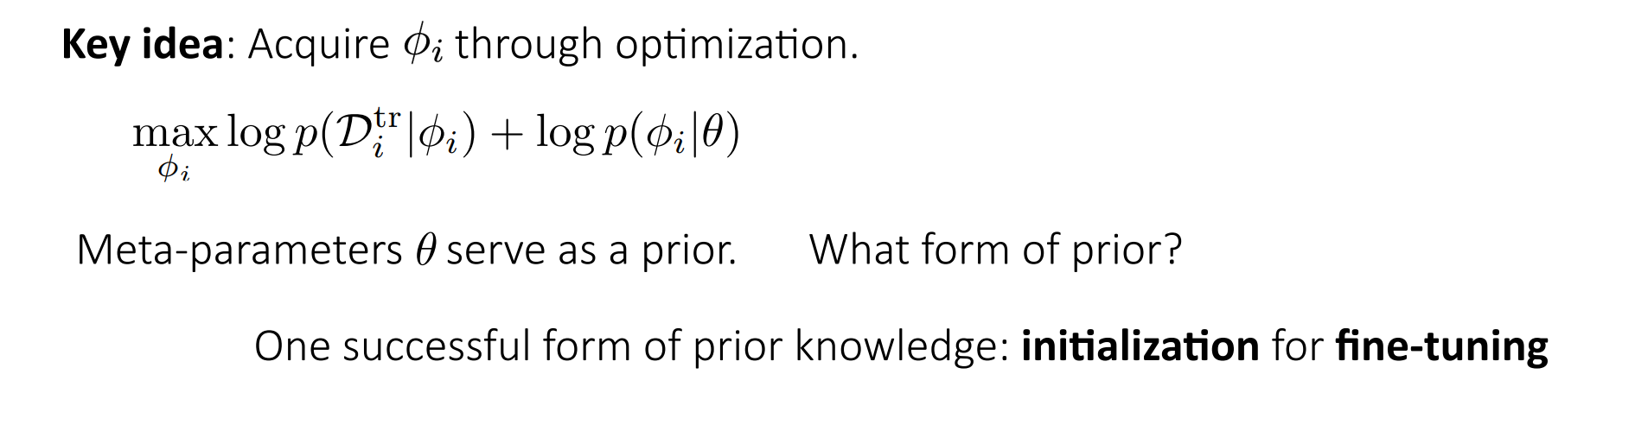
Optimization based Meta Learning

Slide 23
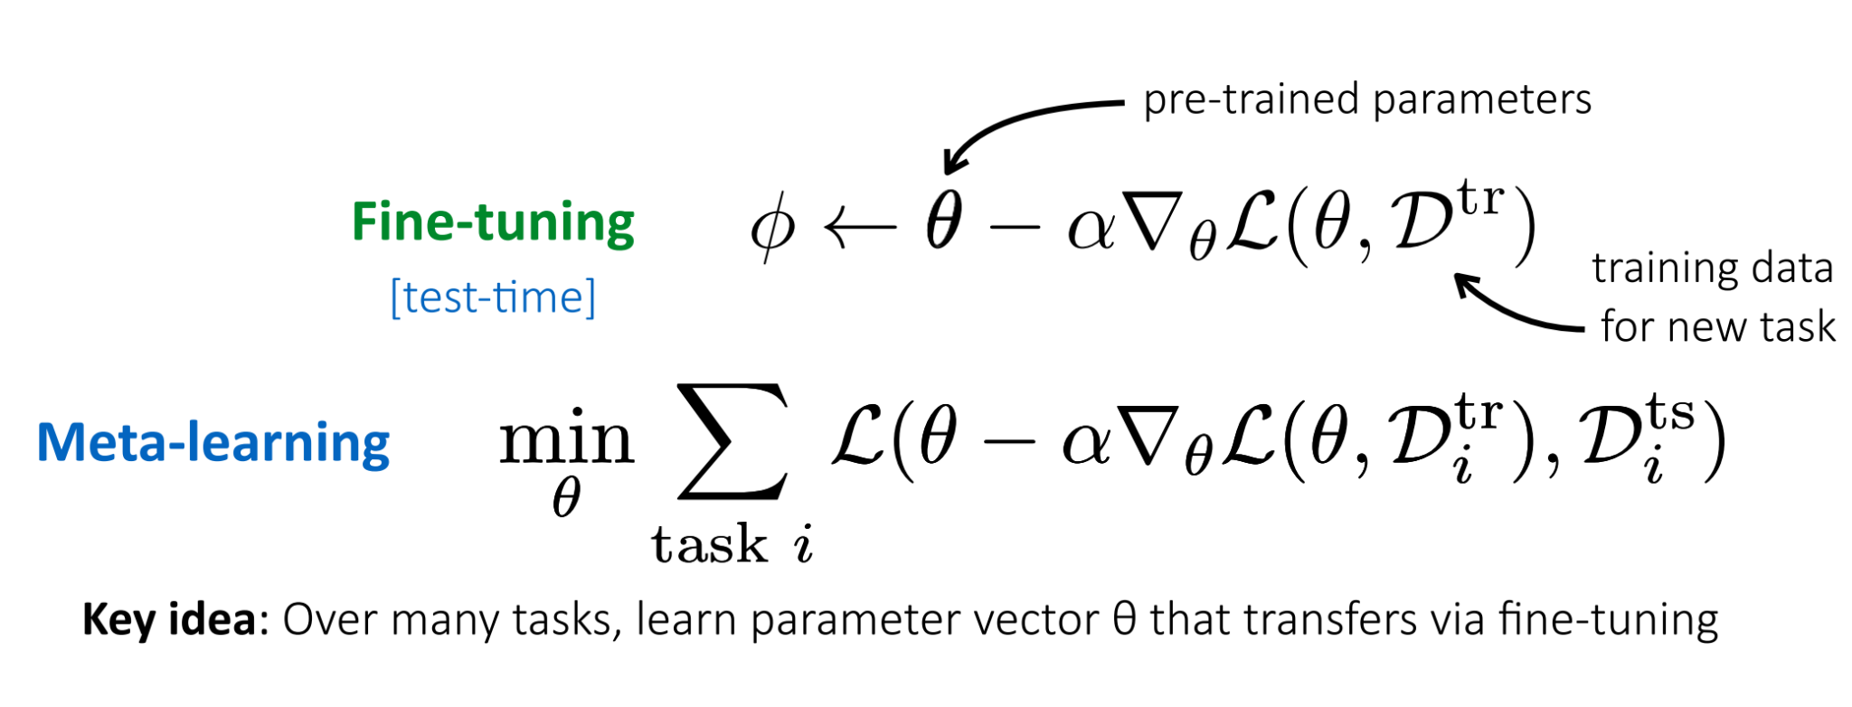
Optimization based Meta Learning

Slide 24
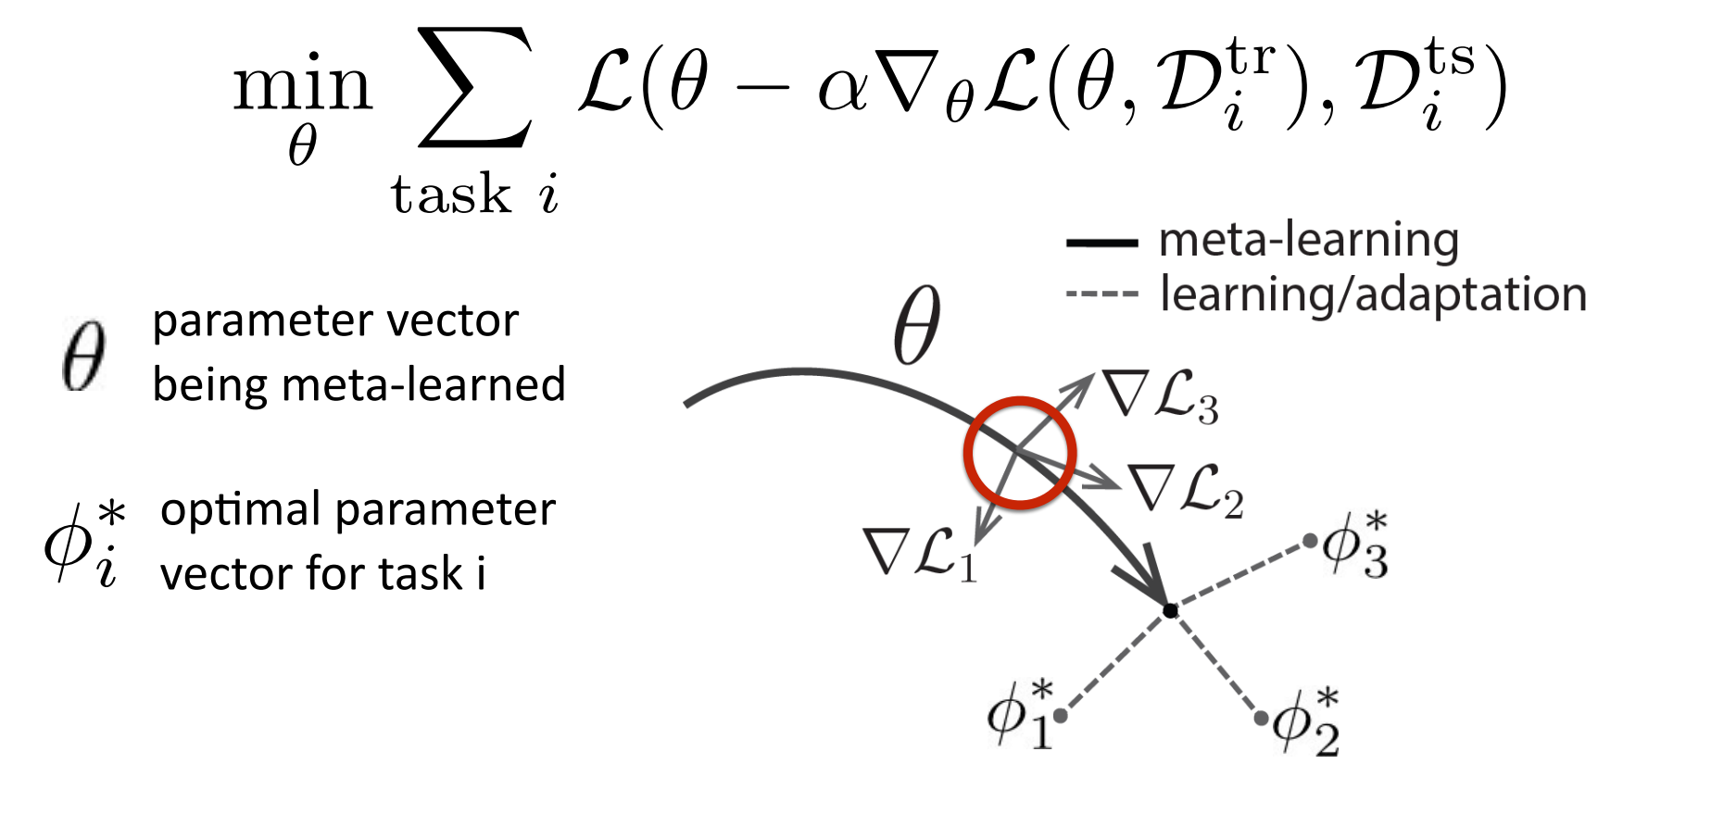
Optimization based Meta Learning

Slide 25
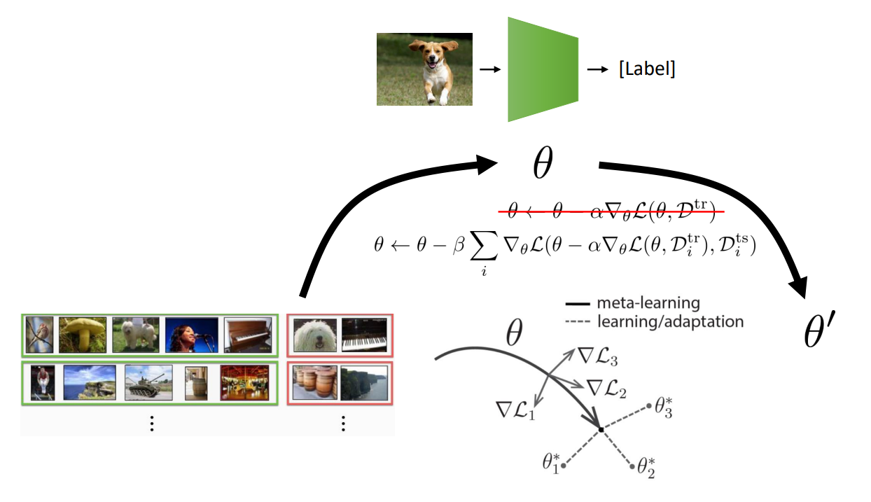
MAML

Slide 26
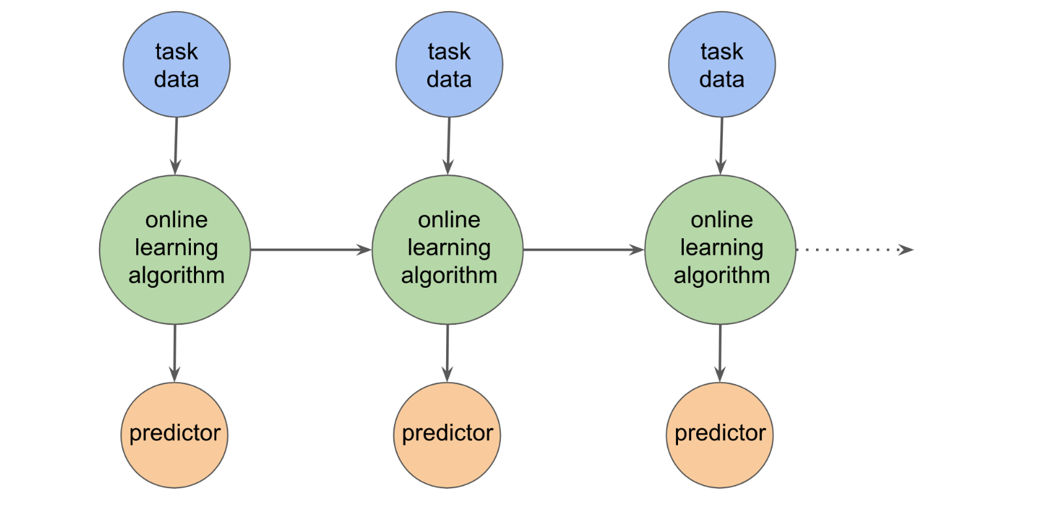
Online Learning (Sequential, Lifelong learning)

Slide 27
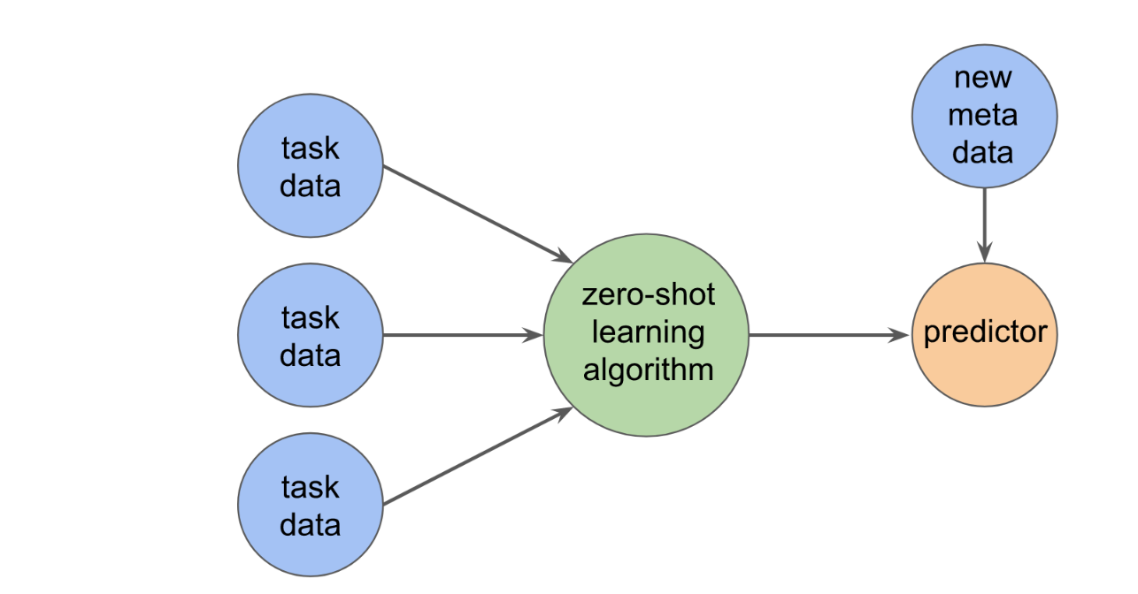
Zero Shot Learning

Slide 28
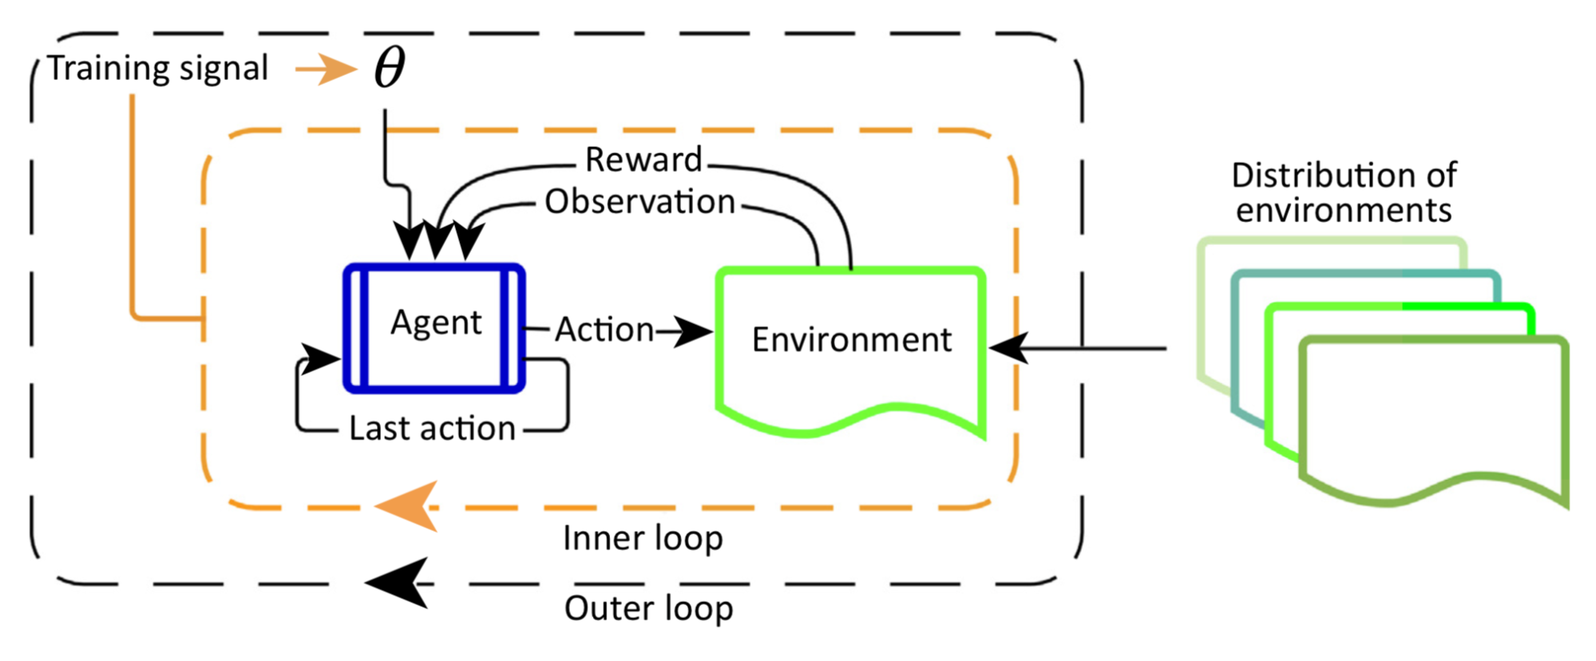
Meta Reinforcement Learning
Meta-RL, containing two optimization loops. The outer loop samples a new environment in every iteration and adjusts parameters that determine the agent’s behavior. In the inner loop, the agent interacts with the environment and optimizes for the maximal reward.

Slide 29
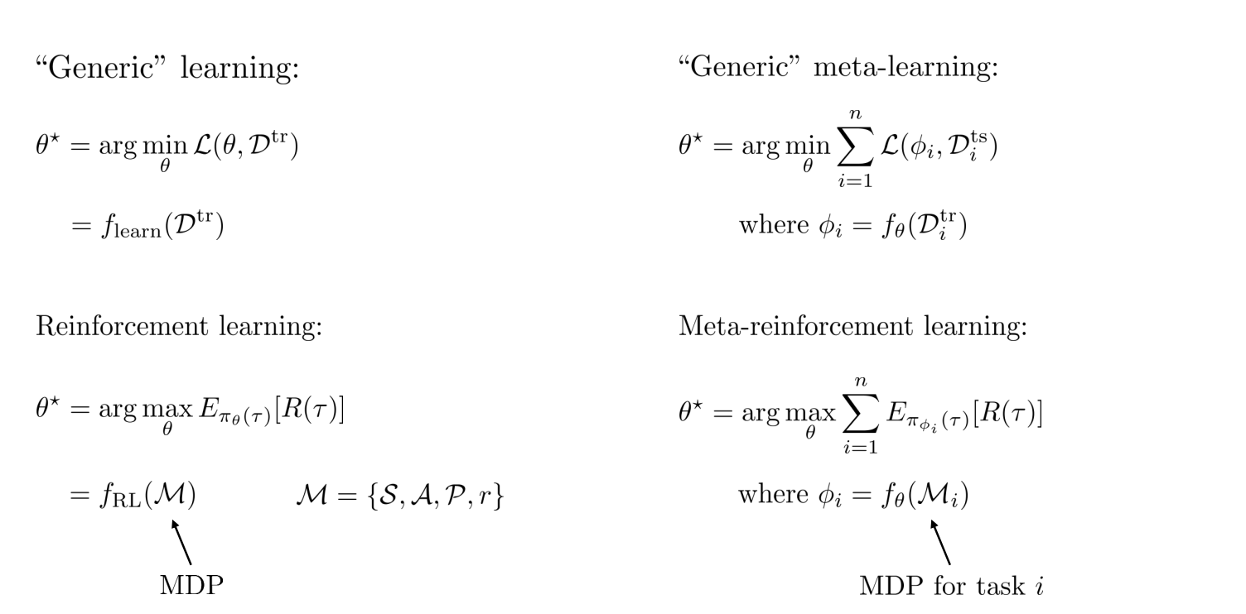
Meta Reinforcement Learning

Slide 30
Personalizing Dialogue Agents via Meta-Learning
- Zhaojiang Lin , Andrea Madotto , Chien-Sheng Wu, Pascale Fung,ACL 2019

Slide 31
Problem
Existing personalized dialogue models use human-designed persona descriptions to improve dialogue consistency
Collecting such descriptions from existing dialogues is expensive and requires hand-crafted feature designs.
So, they proposed an algorithm that will help the model adopt new personalities without any persona description.

Slide 32
Personalized dialogue learning :
Persona-conditioned dialogue :
A personalized dialogue model fθ is trained to produce a response Y = ut conditioned on previous utterances X = {u1, . . . , ut−1} and persona sentences P
fθ(Y |X, P; θ) = p (ut |u1:t−1, p1:m; θ)
Persona-agnostic dialogue :
Instead of conditioning the response on the persona sentences, we can first adapt θ to the set of dialogue made by a persona P and then we only use the dialogue history to condition our response.
fθ(Y |X; θ) = p (ut |u1:t−1; θ)

Slide 33
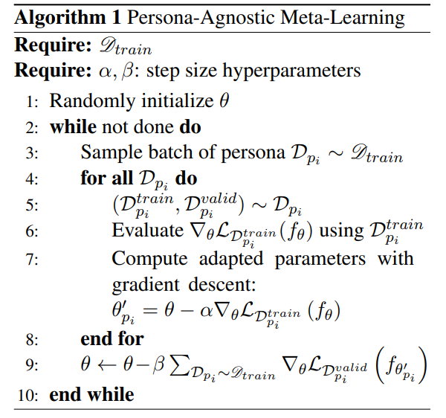
Persona-agnostic meta-learning :
define the persona meta-dataset as D = {Dp1 , . . . , Dpz }, where z is the number of persona.
Before training, D is split into Dtrain, Dvalid, Dtest .
Then we follow this algorithm, shown at the right.

Slide 34
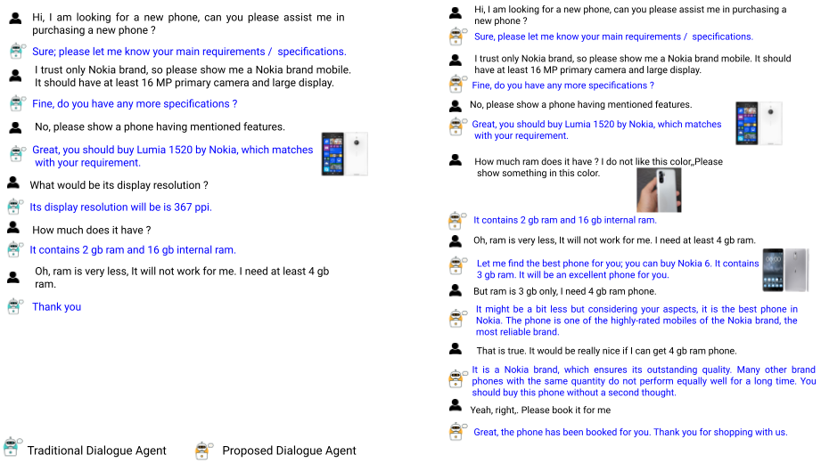
Towards Building An User adaptive Persuasive Multimodal Dialogue System
Problem : Persuasion is a very subjective concern that largely depends on persuadee's personality and persuasion target ;
A person ⇒ Context 1 ⇒ T ⇒ ✔ ; Same person ⇒ Context 2 ⇒ T ⇒ ✘
Idea :
Personalized [Context guided Personality aware] Persuasion
Contribution :
Personalized persuasive dialogue corpus
Persona conditioned Persuasive Dialogue Generation framework

Slide 35
Motivation :
We have 5 sub-domains, i.e – Phone, Tablet, Camera, Laptop, Computer
Conversation distribution is very skewed towards the Phone domain. So performance on the domains other than Phone is a bit bad.
We want to make a model that can easily adapt to the other domains as well.

Slide 36
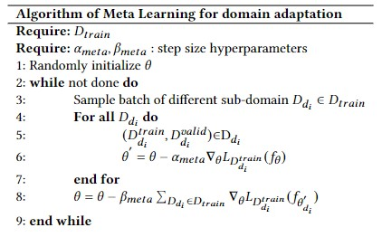
Method :
We merged Laptop & Computer domain to form one domain ‘Laptop’.
The main dataset gets divided into n packets, representing data for n different tasks.
Here we have defined different tasks as conversations from different sub-domain(4 sub-domains we have).
Then we included 3 packets into the training data(Dtrain) and kept the other domain’s data packet as the test data (Dtest).

Slide 37
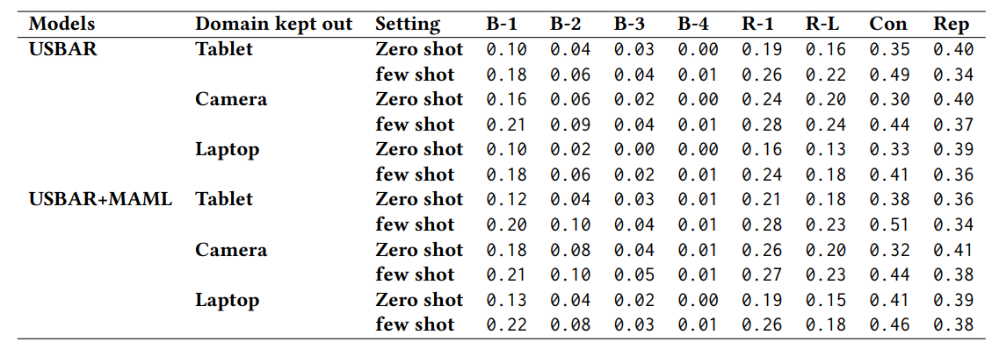
Results

Slide 38
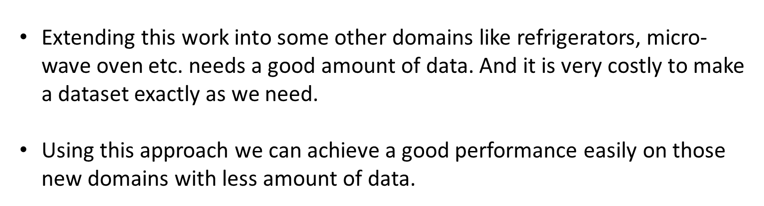
Conclusion

Slide 39
Ethics in Reinforcement Learning

Slide 40
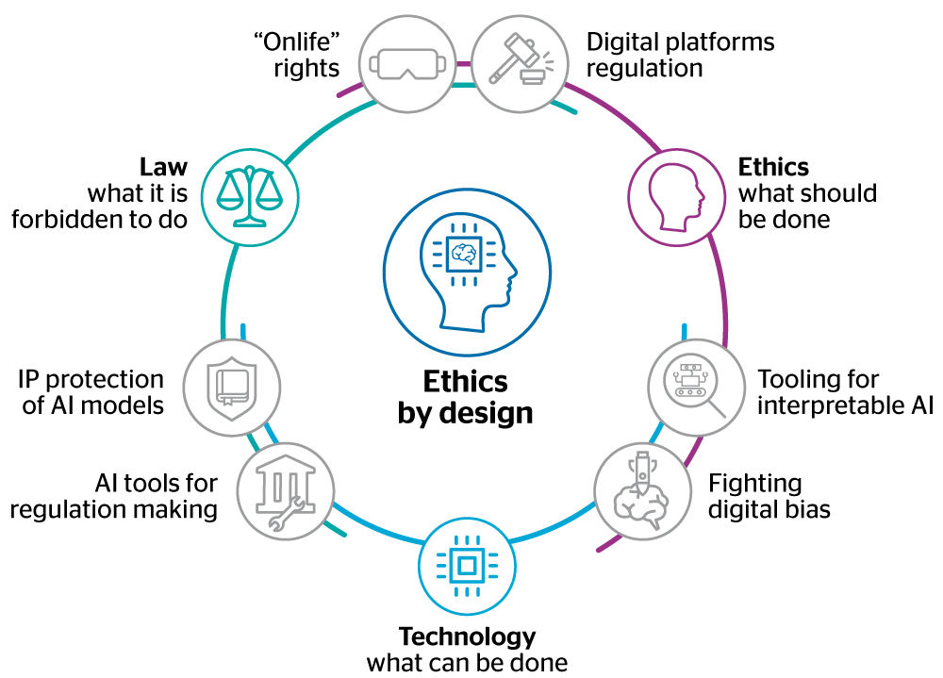
Ethics
“ Ethics is a branch of philosophy that involves systemizing, defending and recommending concepts of right and wrong behaviour”
It has a subfield 'ethics of technology' which tries to answer if it is always, never, or contextually right or wrong to invent and implement a technological innovation. For example: computer viruses, nuclear weapons, environmental stability.

Slide 41
Ethics in AI
It is a part of 'ethics of technology' that is specific to robots, and other artificially intelligent beings.
It can be divided into:
Roboethics: Deals with moral behaviour of human beings as they design, construct, use and treat artificially intelligent beings.
Machine Ethics: Deals with the behaviour of Artificial Moral Agents (AMA).

Slide 42
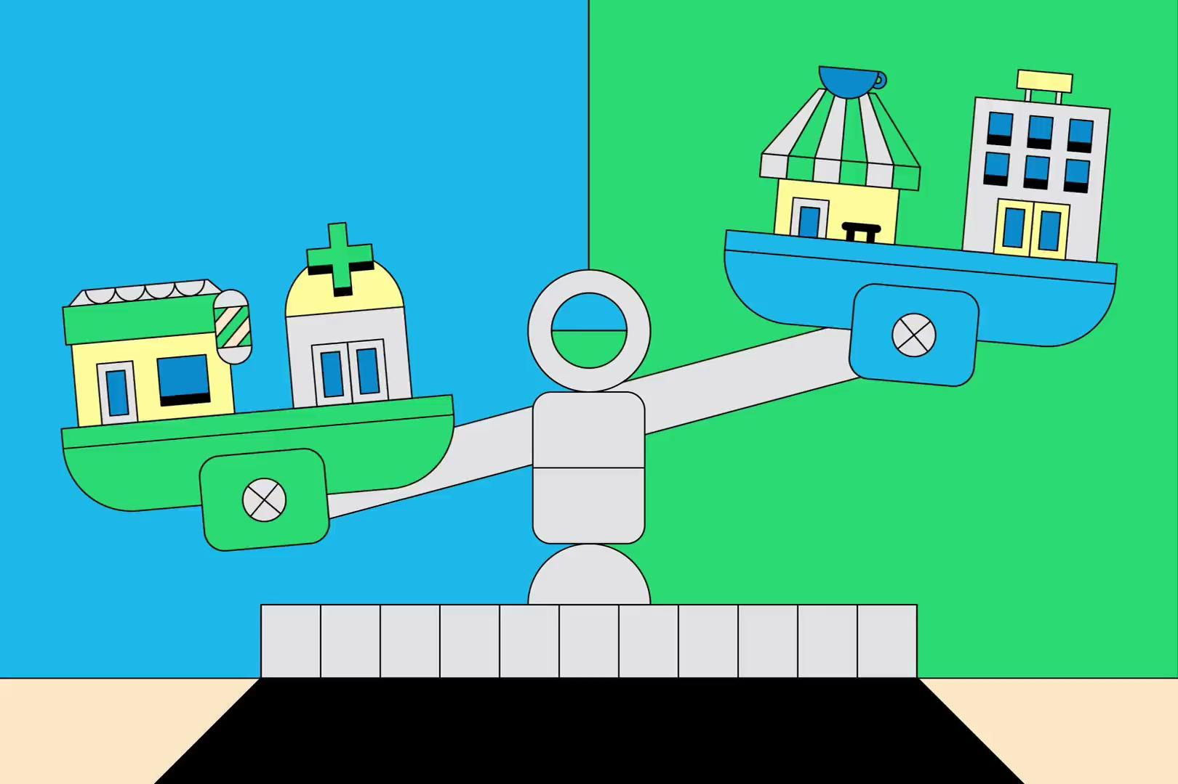

Slide 43
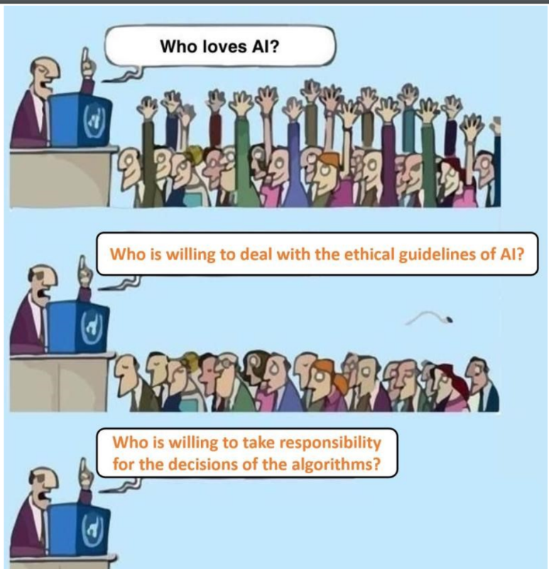

Slide 44
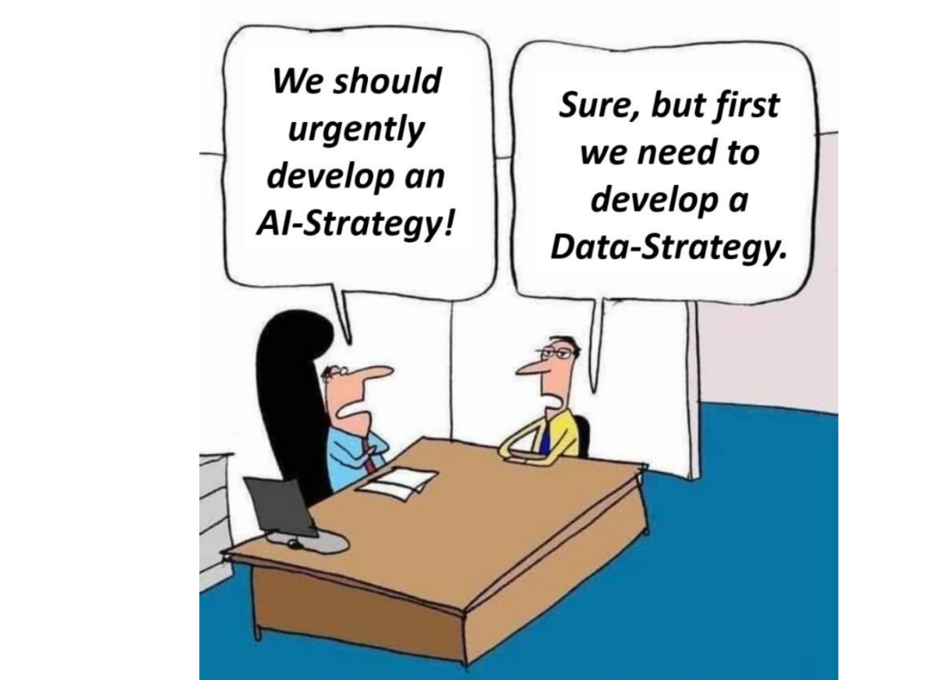

Slide 45
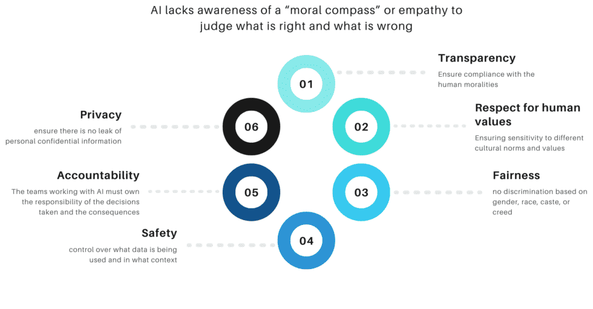
Ethics in AI

Slide 46
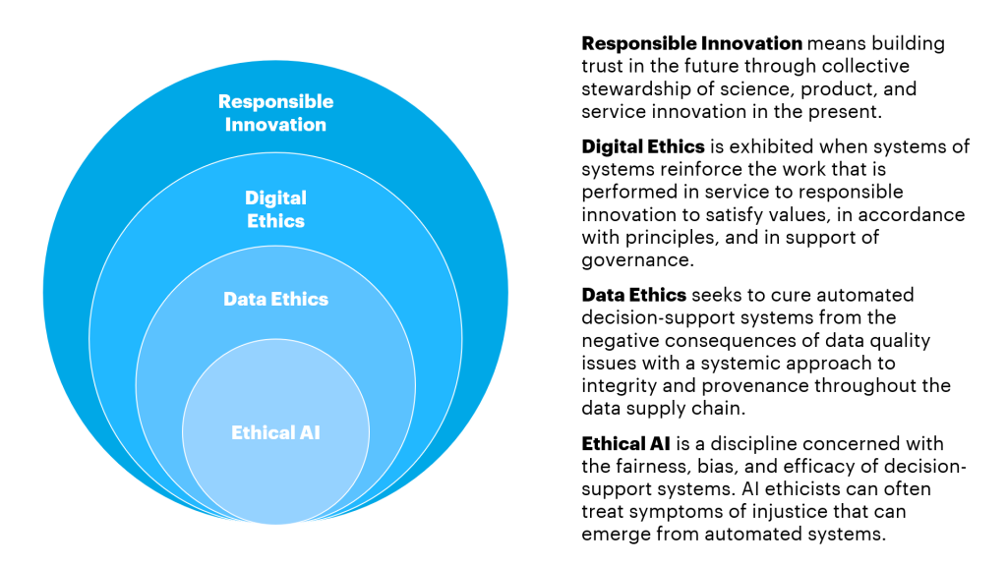
Ethics in AI

Slide 47
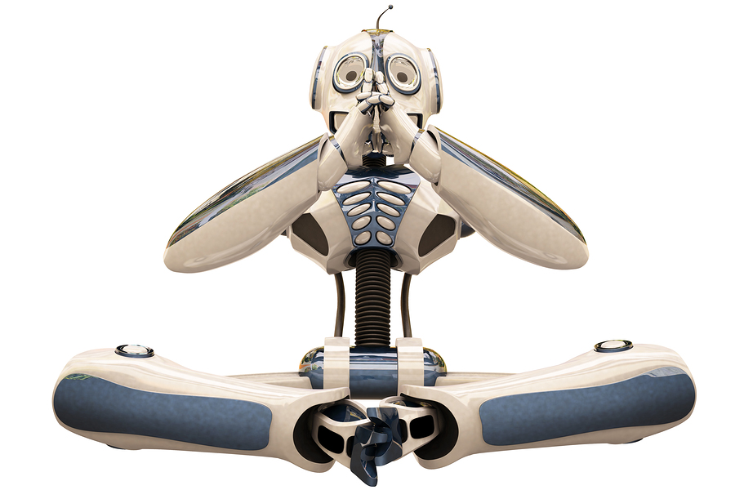
Roboethics
Coined by Gianmarco Veruggio in 2002, it focuses upon how artificially intelligent beings may be used to benefit or harm humans.
It deals with so called Robot Rights, which are the moral obligations of society towards its machines, similar to human rights or animal rights.

Slide 48

Machine Ethics
It focuses on how a machine learns new things – the algorithms involved (discussed later), can it learn on its own, can it become superior to humans etc.

Slide 49
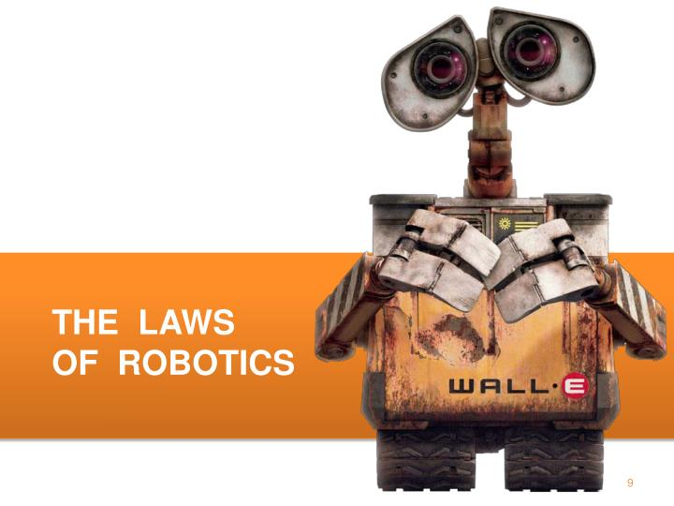

Slide 50
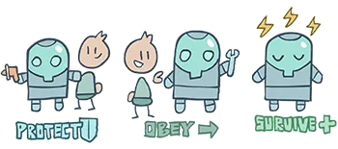
The Three Laws of Robotics
A robot must not injure a human being or, through inaction, allow a human being to come to harm.
A robot must obey the orders given to it by human beings, except where such orders would conflict with the First Law.
A robot must protect its own existence as long as such protection does not conflict with the First or Second Laws.

Slide 51
The Zeroth Law
As the low-numbered law supersede the higher numbered laws, hence it gets its name.
It states that -
A robot must not harm humanity, or, by inaction, allow humanity to come to harm.
How does it decide in practice, as human beings are concrete objects but humanity is an abstraction – injury to it cannot be judged or estimated.
A robot may not harm a human being, unless he finds a way to prove that ultimately the harm done would benefit humanity in general.

Slide 52
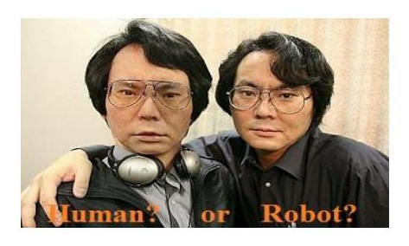
The Fourth Law
It states that -
What happens if a human-like robot is made in future and the robot starts destruction in order to save this one human-like life.
Hence the fourth law states that a robot must identify itself as a robot in all cases or in other words, a robot must know it is a robot.

Slide 53
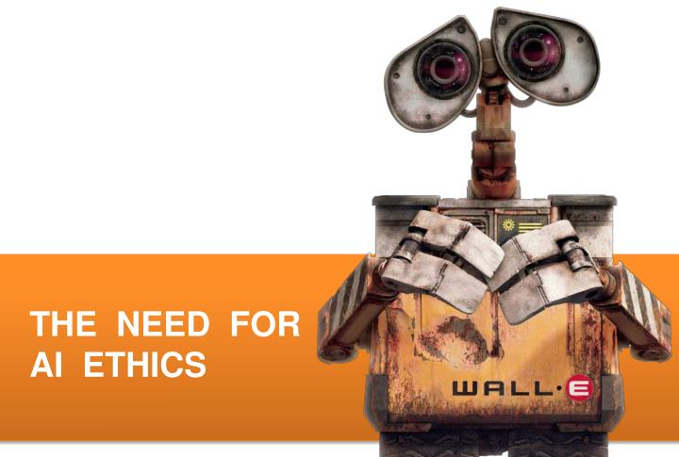

Slide 54
The Need for AI Ethics
If AIs were to have no effective intrusion into our lives then whether they could be ethical would be of interest to only those who engage in thought experiments.
But AIs do intrude in our lives !
The kinds of intrusion are broadly of two sorts :
Intrusions in which we have no choice but to interact with.
Intrusions which cause and are a result of significant changes to culture and human interaction in particular.

Slide 56
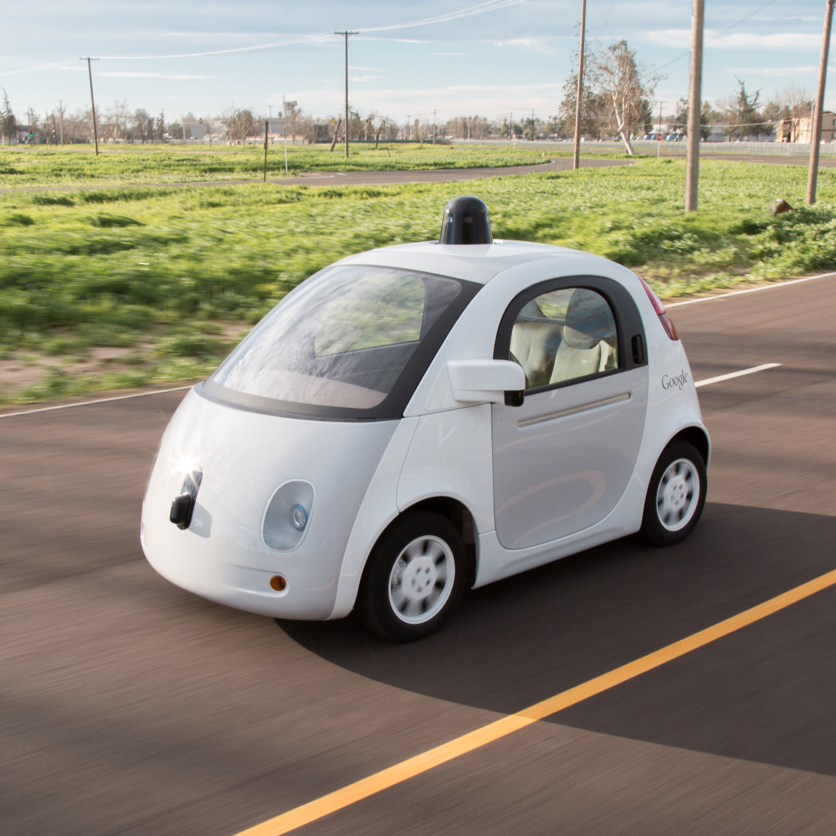

The Need for AI Ethics
An example of the first kind is : Self Driving Car.
While ATMs come under the second category as they influence us by forcing to take currency of specified denominations

Slide 57
Turing Says …
“The original question, ‘Can computers think?’ I believe to be too meaningless to deserve discussion. Nevertheless I believe that at the end of the century the use of words and general educated opinion will have altered so much that one will be able to speak of machines thinking without expecting to be contradicted. I believe further that no useful purpose is served by concealing these beliefs.”

Slide 58
AI Biases
The four most common types of BIAS seen in AI:
Reporting Bias: This type of AI bias arises when the frequency of events in the training dataset doesn’t accurately reflect reality.
E.g : Take an example of a customer fraud detection tool that underperformed in a remote geographic region, marking all customers living in the area with a falsely high fraud score.
Selection Bias: This type of AI bias occurs if training data is either unrepresentative or is selected without proper randomization.
E.g., An example of selection bias is well illustrated by the research conducted by Joy Buolamwini, Timnit Gebru, and Deborah Raji, where they looked at three commercial image recognition products. The tools were to classify 1,270 images of parliament members from European and African countries. The study found that all three tools performed better on male than female faces and showed more substantial bias against darker-skin females, failing on over one in three women of color — all due to the lack of diversity in training data.

Slide 59
AI Biases
Group Attribution Bias: Group attribution bias takes place when data teams extrapolate what is true of individuals to entire groups the individual is or is not part of.
E.g., This type of AI bias can be found in admission and recruiting tools that may favor the candidates who graduated from certain schools and show prejudice against those who didn’t.
Implicit Bias: This type of AI bias occurs when AI assumptions are made based on personal experience that doesn’t necessarily apply more generally.
E.g., if data scientists have picked up on cultural cues about women being housekeepers, they might struggle to connect women to influential roles in business despite their conscious belief in gender equality — an example echoing the story of Google Images’ gender bias.

Slide 60
Types of machine learning bias
Algorithm bias : This occurs when there's a problem within the algorithm that performs the calculations that power the machine learning computations.
Sample bias: This happens when there's a problem with the data used to train the machine learning model. In this type of bias, the data used is either not large enough or representative enough to teach the system.
For example, using training data that features only female teachers will train the system to conclude that all teachers are female.

Slide 61
Types of machine learning bias
Prejudice bias : In this case, the data used to train the system reflects existing prejudices, stereotypes and/or faulty societal assumptions, thereby introducing those same real-world biases into the machine learning itself.
For example, using data about medical professionals that includes only female nurses and male doctors would thereby perpetuate a real-world gender stereotype about healthcare workers in the computer system.
Measurement bias : As the name suggests, this bias arises due to underlying problems with the accuracy of the data and how it was measured or assessed.
a system being trained to precisely assess weight will be biased if the weights contained in the training data were consistently rounded up.

Slide 62
Types of machine learning bias
Exclusion bias : This happens when an important data point is left out of the data being used --something that can happen if the modelers don't recognize the data point as consequential.

Slide 63
How to prevent bias
Select training data that is appropriately representative and large enough to counteract common types of machine learning bias, such as sample bias and prejudice bias.
Test and validate to ensure the results of machine learning systems don't reflect bias due to algorithms or the data sets.
Monitor machine learning systems as they perform their tasks to ensure biases don't creep in over time as the systems continue to learn as they work.
Use additional resources, such as Google's What-if Tool or IBM's AI Fairness 360 Open Source Toolkit, to examine and inspect models.

Slide 64
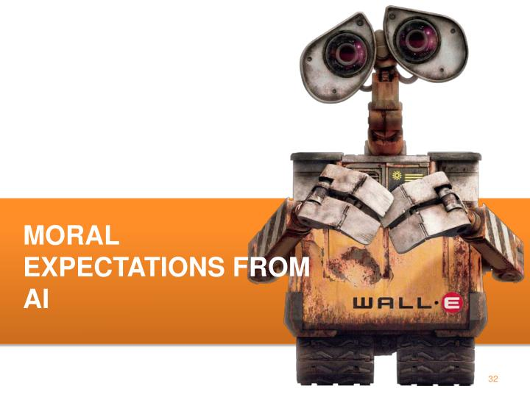

Slide 65
Qualities in AI
Qualities that we usually consider while making machines
• Powerful (Speed, Accuracy etc.)
• Scalability – how an algorithm scales up on larger parallel systems
Qualities that we need to consider
Transparency
Auditability
Incorruptibility
Responsibility
Predictability

Slide 66
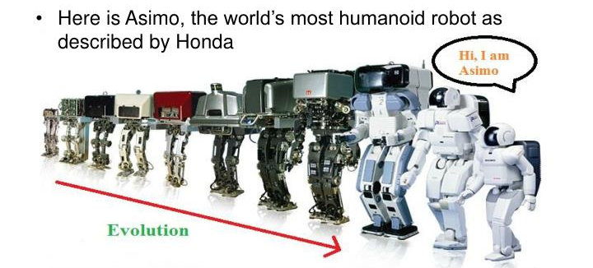
Asimo

Slide 67
Asimo
ASIMO has the ability to recognize moving objects, postures, gestures, its surrounding environment, sounds and faces, which enables it to interact with humans.
The robot can detect the movements of multiple objects by using visual information captured by two camera "eyes" in its head and also determine distance and direction.
The robot interprets voice commands and human gestures, enabling it to recognize when a handshake is offered or when a person waves or points, and then respond accordingly. ASIMO's ability to distinguish between voices and other sounds allows it to identify its companions.
ASIMO is able to respond to its name and recognizes sounds associated with a falling object or collision. This allows the robot to face a person when spoken to or look towards a sound.
ASIMO responds to questions by nodding or providing a verbal answer in different languages and can recognize approximately 10 different faces and address them by name.[15]

Slide 68
Some Ethical Issues
Reporting of results
Interpretability of algorithm behaviour
Discrimination and bias learned from human data
The possibility of Artificial General Intelligence

Slide 69
Reporting of results
Statistical methodological issues
Failure to report negative results.
Cherry-picking easy tasks that look impressive.
Failure to investigate performance properly.
Overall: the AI Hype problem!

Slide 70
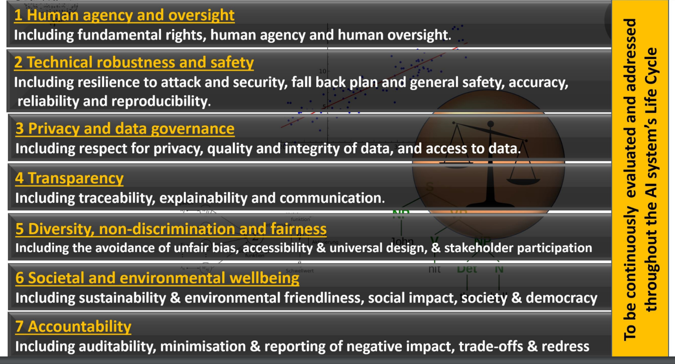
Requirements of Trustworthy AI

Slide 71
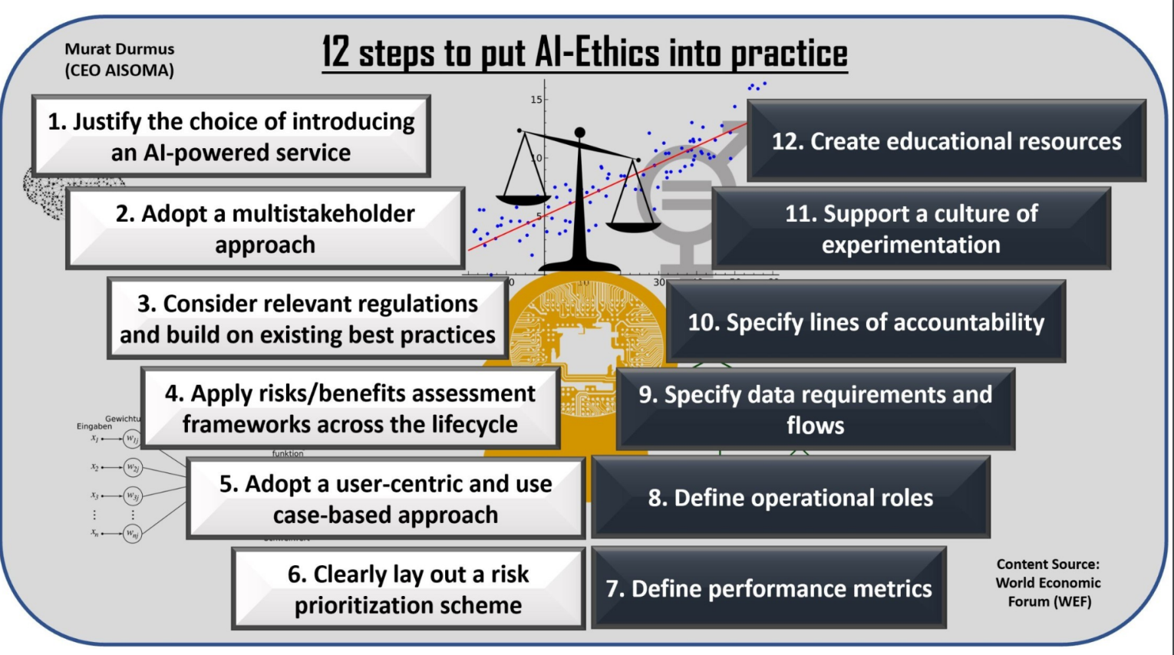

Slide 72
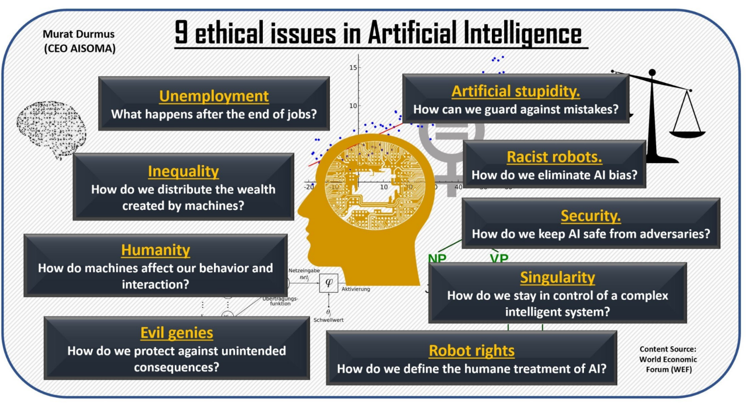

Slide 73
Ethics : Opposition
AI should not replace
Doctors
Judges
Police officers,etc

Slide 74
Some Personal Experiences

Slide 75


Slide 76
Related Publications
A. Tiwari, S. Saha , P. Bhattacharyya (2022), ``A Knowledge Infused Context Driven Dialogue Agent for Disease Diagnosis using Hierarchical Reinforcement Learning", Knowledge Based Systems (impact factor:8.038) .
A. Tiwari, T. Saha, S. Saha , S. Sengupta, A. Maitra, R. Ramnani, P. Bhattacharyya (2021), ``A Persona Aware Persuasive Dialogue Policy for Dynamic and Co-operative Goal Setting", Expert Systems with Applications (impact factor: 6.954, h5-index: 118).
A. Tiwari, T. Saha, S. Saha, S. Sengupta, A. Maitra, R. Ramnani, and P. Bhattacharyya(2021), ``Multi-Modal Dialogue Policy Learning for Dynamic and Co-operative Goal Setting" in International Joint Conference on Neural Networks (IJCNN) 2021, 18-22 July 2021
T. Saha, D. Gupta, S. Saha , P. Bhattacharyya (2021), ``A Unified Dialogue Management Strategy for Multi-Intent Dialogue Conversations in Multiple Languages", ACM Transactions on Asian and Low-Resource Language Information Processing
A. Tiwari, T. Saha, S. Saha, S. Sengupta, A. Maitra, R. Ramnani, P. Bhattacharyya (2021), ``A Dynamic Goal Adapted Task Oriented Dialogue Agent", Plos One (h5 index: 175, impact factor: 2.74)
T. Saha, N. Priya, S. Saha and P. Bhattacharyya (2021), ``A Transformer based Multi-task Model for Domain Classification, Intent Detection, and Slot-Filling" in International Joint Conference on Neural Networks (IJCNN) 2021, 18-22 July 2021.
T. Saha, S. Chopra, S. Saha, P. Bhattacharyya and Dr. P. Kumar (2021), ``A Large-Scale Dataset for Motivational Dialogue System: An Application of Natural Language Generation to Mental Health", in International Joint Conference on Neural Networks (IJCNN) 2021, 18-22 July 2021
T. Saha, A. Upadhyaya, S. Saha, P. Bhattacharyya (2021), ``Towards Sentiment and Emotion aided Multi-modal Speech Act Classification in Twitter", in NAACL-HLT 2021, June 6-11, 2021
T. Saha, S. Chopra, S. Saha and P. Bhattacharyya (2020), ``Reinforcement learning based personalized neural response generation", in International Conference on Neural Information Processing (ICONIP) 2020, 18-22 November, 2020
N. Priya, A. Tiwari and S. Saha(2021), ``Context Aware Joint Modeling of Domain Classification, Intent Detection and Slot Filling with Zero-shot Intent Detection Approach", in 28th International Conference on Neural Information Processing (ICONIP-2021),. December 8 - 12, 2021, BALI, Indonesia
T. Saha, A. Patra, S. Saha and P. Bhattacharyya (2020), `` Towards Emotion-aided Multi-modal Dialogue Act Classification", In ACL 2020, July 5-10, 2020, Seattle, Washington

Slide 77
References
Li, X., Chen, Y. N., Li, L., Gao, J., & Celikyilmaz, A. (2017, November). End-to-End Task-Completion Neural Dialogue Systems. In Proceedings of the Eighth International Joint Conference on Natural Language Processing (Volume 1: Long Papers) (pp. 733-743).
Shi, W., & Yu, Z. (2018, July). Sentiment Adaptive End-to-End Dialog Systems. In Proceedings of the 56th Annual Meeting of the Association for Computational Linguistics (Volume 1: Long Papers) (pp. 1509-1519).
Wang, X., Shi, W., Kim, R., Oh, Y., Yang, S., Zhang, J., & Yu, Z. (2019). Persuasion for good: Towards a personalized persuasive dialogue system for social good. arXiv preprint arXiv:1906.06725.
Shi, W., Wang, X., Oh, Y. J., Zhang, J., Sahay, S., & Yu, Z. (2020, April). Effects of persuasive dialogues: testing bot identities and inquiry strategies. In Proceedings of the 2020 CHI Conference on Human Factors in Computing Systems (pp. 1-13).
Tang, K. F., Kao, H. C., Chou, C. N., & Chang, E. Y. (2016, December). Inquire and diagnose: Neural symptom checking ensemble using deep reinforcement learning. In NIPS Workshop on Deep Reinforcement Learning.
Kao, H. C., Tang, K. F., & Chang, E. (2018, April). Context-aware symptom checking for disease diagnosis using hierarchical reinforcement learning. In Proceedings of the AAAI Conference on Artificial Intelligence (Vol. 32, No. 1).
Wei, Z., Liu, Q., Peng, B., Tou, H., Chen, T., Huang, X. J., ... & Dai, X. (2018, July). Task-oriented dialogue system for automatic diagnosis. In Proceedings of the 56th Annual Meeting of the Association for Computational Linguistics (Volume 2: Short Papers) (pp. 201-207).
Liao, K., Liu, Q., Wei, Z., Peng, B., Chen, Q., Sun, W., & Huang, X. (2020). Task-oriented dialogue system for automatic disease diagnosis via hierarchical reinforcement learning. arXiv preprint arXiv:2004.14254.
Rasmussen, K., Belisario, J. M., Wark, P. A., Molina, J. A., Loong, S. L., Cotic, Z., ... & Car, J. (2014). Offline eLearning for undergraduates in health professions: a systematic review of the impact on knowledge, skills, attitudes and satisfaction. Journal of global health, 4(1).
Ramakrishnan, N., Vijayaraghavan, B. K. T., & Venkataraman, R. (2020). Breaking barriers to reach farther: A call for urgent action on tele-ICU services. Indian Journal of Critical Care Medicine: Peer-reviewed, Official Publication of Indian Society of Critical Care Medicine, 24(6), 393.
Fox, S., & Duggan, M. (2013). Health online 2013. Health, 2013, 1-55.
Conversational AI Market by Component (Platform and Services), Type (IVA and Chatbots), Technology (ML and Deep Learning, NLP, and ASR), Application, Deployment Mode (Cloud and On-premises), Vertical, and Region - Global Forecast to 2025.” Markets and Markets, June 2020. Retrieved from: https://www.researchanmarkets.com/reports/5136158/conversational-ai-market-by-component-platform?utm_sourc=GNOM&utm_medium=PressRelease&utm_code=m3d7t3&utm_campaign=1426757+-+Global+Conversational+AI+Market+Analysis+2020-2025&utm_exec=joca220prd

Slide 78
For any further question/remark/suggestion, please contact
Dr. Sriparna Saha
Email Id : sriparna@iitp.ac.in

Slide 79
How to learn an Optimal Policy ?
How good is a state (S) ?
Expected cumulative reward from state, S
Intitution :
good state : If the state, S, is more likely to lead to a path that ends up to a goal state.
bad state : If the state S, is more likely to lead to a path that would not be end up at one of goal states.
How good or bad (intensity / subjectivity ) ?
Value (S₁₁) = p (S₁₁ → S₂₁) * 8 + p (S₁₁ →S₂₂ ) * 2 + 50 (Assuming 𝜸 = 1)
= 0.9 * 8 + 0.1 * 2 + 50
= 57.4

Slide 80
State
Hidden Layer1
Hidden Layer2
Action
Value

Slide 81


An Example
y =0.9, two terminal states with R = +1 and -1

Slide 82


An Example

Slide 83


An Example

Slide 84

An example

Slide 85
Meta-Learning

Slide 86
Motivation :
Learning how to learn -
Transfer learning is getting heavily used.
We are loading a set of pre-trained parameters (i.e- BERT, GPT) and fine-tuning it on new tasks.
Need to set the parameters in such a way that they can be easily and better adaptable.

